Slide 1
Carbon Capture And Storage Using Two Stage Aqueous Mineral Carbonation

Slide 2
Supervisor: Dr. Imran Rashid
Group Members
Waleed Akbar (2018-CH-253)
M. Shaiq Gohar (2018-CH-245)
Sarmad Hashmi (2018-CH-275)
Department of chemical polymers and composite material engineering

Slide 3
Contents
Introduction
Process Selection
Raw Material Selection
Process Flow Diagram and PFD description
Capacity Selection
Material and Energy Balance
Project Selection

Slide 4

Introduction
CO₂ is the most important greenhouse gas. Green house gasses are the one which absorbs and emit radiant energy within the thermal infrared range. So their excessive amount in atmosphere is dangerous
Carbon sequestration is the long-term removal, capture or sequestration of carbon dioxide from the atmosphere to slow or reverse atmospheric CO2 pollution and to mitigate or reverse global warming

Slide 5
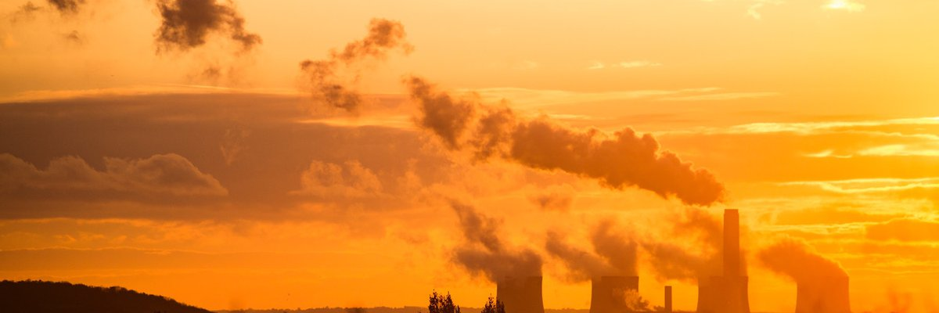
Project selection

Slide 6
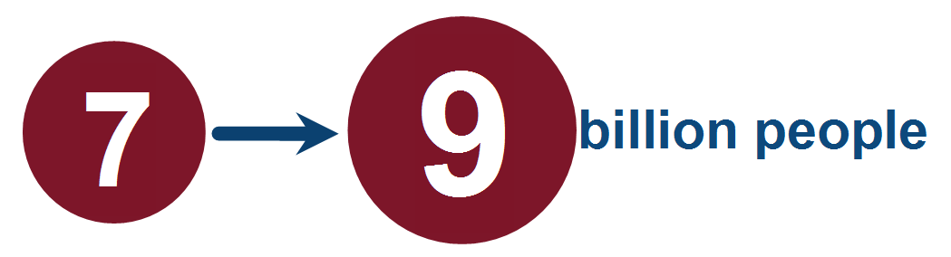
Why we select this project
By 2050, global population will rise from
&
the World enter demand is expected to increase by 50% over the next 20 years.
According to the recent Panel on Climate Change, global greenhouse gas (GHG) emissions must be reduced by 50 to 80 percent to avoid dramatic consequences of global warming.

Slide 7
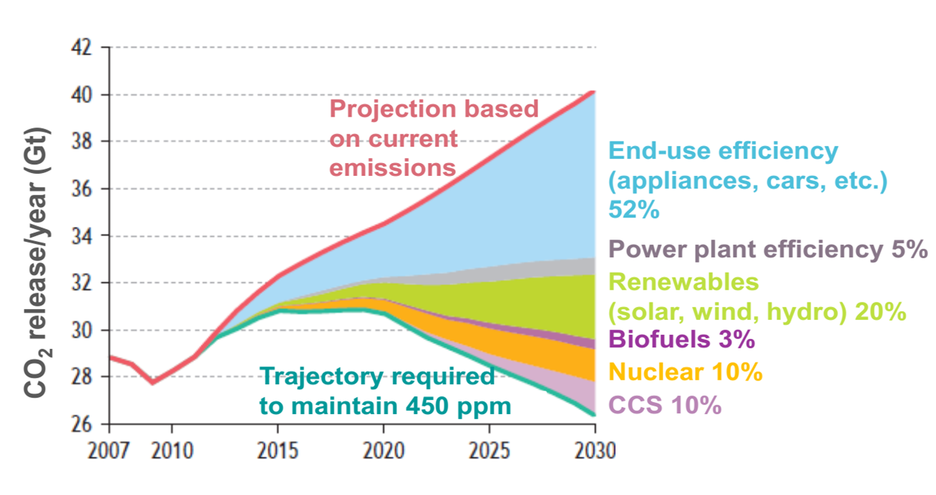
International Energy Agency, 2009
To avoid emission of CO2 in atmosphere we chose this

Slide 8
Process selection

Slide 9
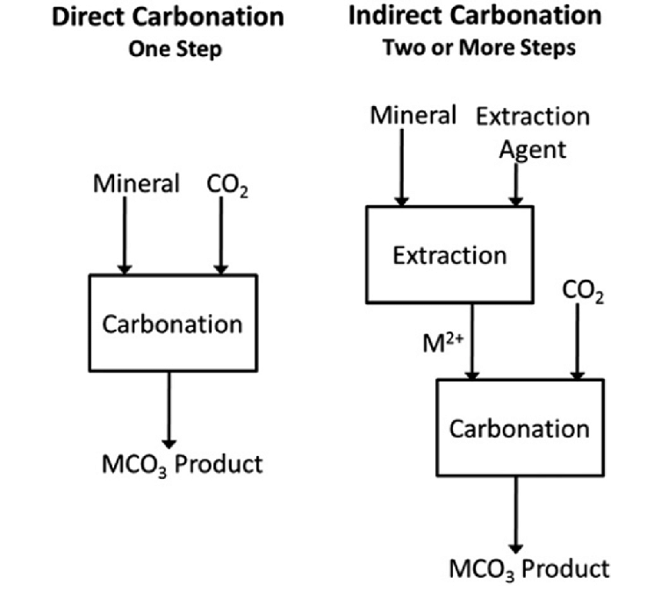
We choose double stage carbonation

Slide 10
Raw material selection

Slide 11
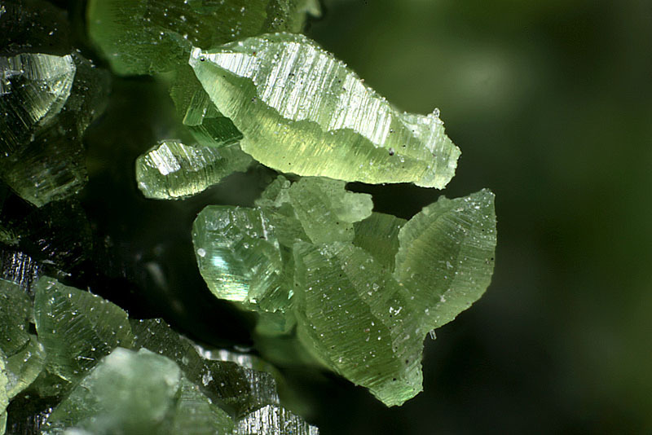
We select Lizardite as raw material
Formula : Mg₃(Si₂O₅)(OH)₄
Color : green, brown, light yellow to white
Lustre : Resinous, Waxy, Greasy
Hardness:2½
Specific Gravity:2.55
Crystal System : Trigonal
Member of : Serpentine Subgroup

Slide 12
Process flow diagram

Slide 14
PFD description
Flue gases(CO2+N2) are coming from the plant that has temp. of 120C. These gases send to cooler where temp. reduces to 50C at atmospheric pressure.
Then these flue gases send to adsorber where the N2 is extracted and it converts rich amines into lean amines. The rich amines are made in the stripper where lean amines stream is attached and stripper makes amines rich that transfer to adsorber where N2 is extracted. This process is continuous for extraction of N2 and streams b/w adsorber and stripper are transferred with the help of pumps.

Slide 15
Conti….
After stripper stream(99%pure,CO2) is send to compressor. From where it is send to the carbonation reactor and precipitator. CO2 analyzer is installed that analyze CO2.
We prepare slurry in mixer by adding activated feed material (Lizardite) and distilled water. It is send to the heater with the help of pump where its temp. rises. So that it can send to the carbonation reaction.
In carbonation reactor, slurry is added at 45C with 5 bar pressure and CO2 from compressor is added. From reactor CO2 is send to treated gas holder by analyzing with the help of CO2 analyzer.

Slide 16
Conti….
From Carbonation reactor , product is send to the filter where undesired solids are removed from the product. From filter product is send to precipitator with the help of pump. After reaction in reactor product temp. is 90C and pressure is 2 bar.
In precipitator , product is added and CO2 that is 99% pure from compressor is added. Temp. reduced to 40C and stream is send to filter. From filter circulated water and product is separated. Our product is Nesquehonite.

Slide 17
Capacity selection

Slide 18
Capacity is selected as
1kg of CO₂ required 2 kg of lizardite
1 ton = 1000kg
1 ton CO₂ captured per day = 1000kg / day
CO₂ capture per hour = 1000/24 = 41.67kg/h
So, plant is designed to capture and store 41.67kg of CO₂
1kg CO₂ require = 2kg of lizardite
41.67kg/h CO₂ require = 83.34kg/h lizardite

Slide 19
Material Balance

Slide 20
Raw materials required
We need 2% conc. Slurry for the reaction
2% lizardite (solids)
98% sol (water)

Slide 21
Slurry preparation
Lizardite flow rate = 83.334kg/h
Total inlet flow rate = 83.334/0.02 = 4166.7kg/h
Composition of lizardite = 0.02
Composition of solution = 0.98
Flow rate of solution = 4166.7(98)/100 = 4083.366kg/h

Slide 22
Balance for slurry

Slide 23
Adsorber Balance
2 streams are input in which one is rich amines and other is CO₂
2 streams output 1 is lean amines and other is N₂

Slide 24
Stripper balance
1 stream is input that is lean amines
2 streams are out put 1 is rich mines and other is CO₂

Slide 25
Reactor balance
F+G=H+I
4166.7+86.57 = H+I
H+I = 4253.27KG/H
Lizardite balance
FAo =83.334kg/h = 8333g/h
M.M of lizardite = 277.11g/mol
N=mass/M.M= 8333/277.11=300.72 gmol/hr
FA =Fao (1-XA) = 300.725(1-0.5) =150.362
X(dissolution) at 45C,5 bar 600rpm in one hour taken a 50%.

Slide 26
Contin….
C2O Balance
FB = FB0 –FA0 Xa (b/a)
Lizardite and CO₂ reaction
MgSiO₂O₅(OH)₄ + 3CO₂ 3MgCO₃ + 2SiO₂ + H₂O + 64KJ/mol
Fb0 = CO₂ in feed/M.W of CO₂ = 41667/44= 946.96 gmol/h
Fb =946.96-(300.725)(0.5)(5)
=195.14moles/h

Slide 27
Contin….
MgCO3 Balance
Fc = Fco-FaoXa(c/a)
MgCO3 was not initially present. So, Fco=0
Fc=0+300.725(0.5)(3)
Fc=451.087moles/h
SiO2 Balance
Fd= Fdo-FaoXa(d/a)
Fdo=0
Fd=300.725(0.5)(2)
Fd=300.725moles/h

Slide 28
Contin….
In product stream
Lizardite=150.3625moles/h(277.11g/moles)=41.66kg/h
CO₂
195.14(44)= 8.58kg/h
MgCO₃
451.0875(84)=37.89kg/h
SiO₂
300.725(60)= 18.043kg/h
We apply CO2 balance assuming that CO2 removed from the reactor is 99% pure

Slide 29
Contin….
0.99H=8.58
H=8.66kg/h
I=4244.61kg/h
Composition of the stream is
Lizardite= 41.66/4244.61=0.0098
MgCO₃=37.89/4244.61=0.0089
SiO₂=18.043/4244.61=0.0042
H₂O=4146.98/4244.61=0.977

Slide 30
Contin….
2 streams are input 1 is slurry and other is CO₂
2 streams are output 1 is CO₂ and other is Product(Nesquehonite)

Slide 31
Overall Material Balance
2 streams are input 1 is CO₂ and other is Slurry
3 streams are output N₂,H₂O and our product(nesquehonite)

Slide 32
Energy Balance

Slide 33
Overall energy balance
Streams similar to material

Slide 34
Adsorber balance
Streams similar to material

Slide 35
Stripper balance
Streams similar to material

Slide 36
Heater balance
Streams similar to material

Slide 37
Reactor balance
Streams similar to material

Slide 38
The End

